Slide 1
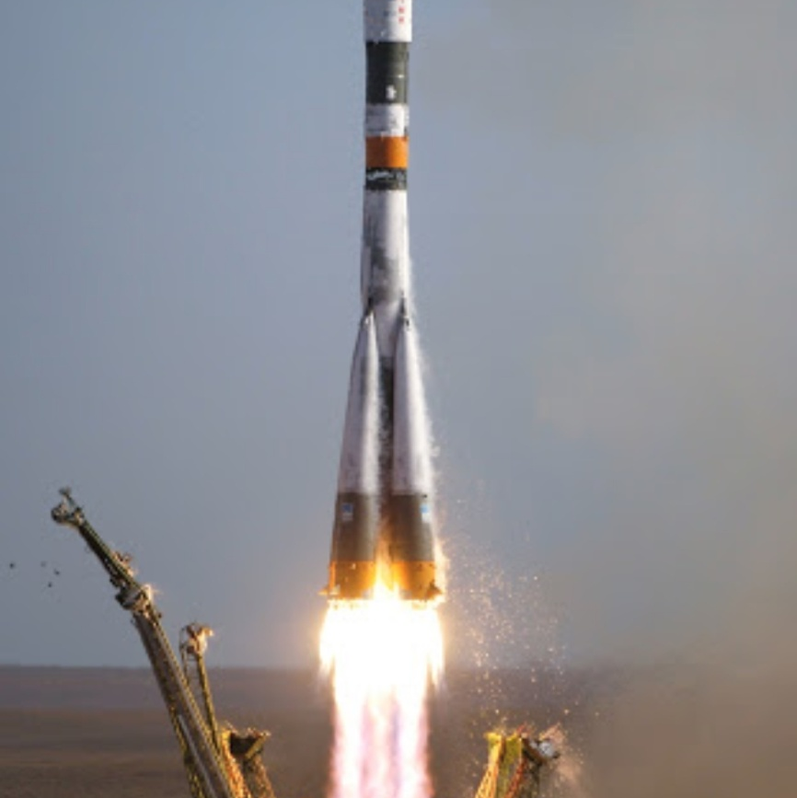
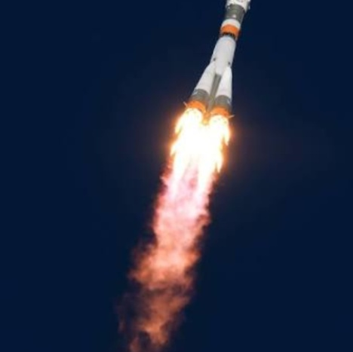
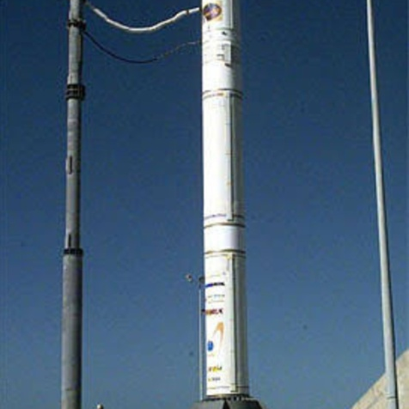
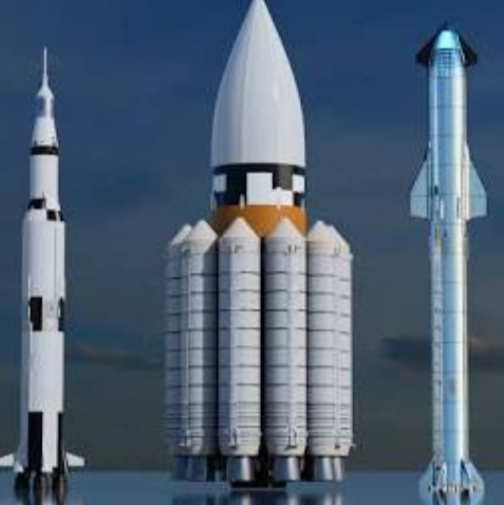

Free Presentation
By:-Gourav, Sauryaman,Jyotiprakash and Soumya
ation
http://www.free-powerpoint-templates-design.com

Slide 2

Agenda Style
01
Contents
Get a modern PowerPoint Presentation that is beautifully designed. I hope and I believe that this Template will your Time.
02
Contents
Get a modern PowerPoint Presentation that is beautifully designed. I hope and I believe that this Template will your Time.
03
Contents
Get a modern PowerPoint Presentation that is beautifully designed. I hope and I believe that this Template will your Time.
04
Contents
Get a modern PowerPoint Presentation that is beautifully designed. I hope and I believe that this Template will your Time.

Slide 3
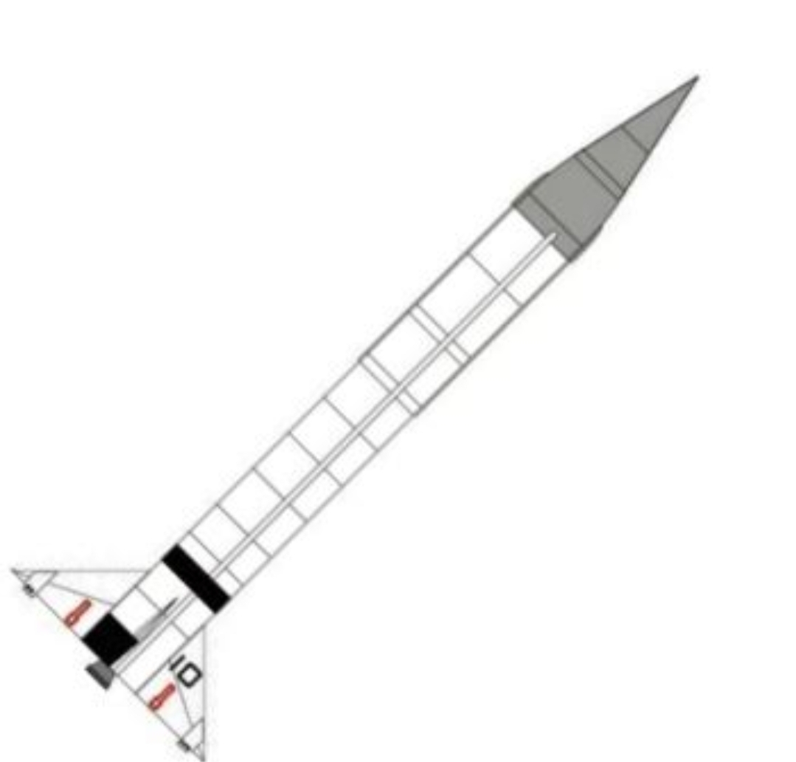
Introduction to rocketry
A rocket in simplest term is enclosing a gas under pressure. A small opening at
one end of the chamber allows the gas to escape,
and in doing so provides a thrust that propels the
rocket in the opposite direction. A good example of
this is a balloon. Air inside a balloon is compressed
by the balloon’s rubber walls. The air pushes back
so that the inward and outward pressing forces
balance. When the nozzle is released, air escapes
through it and the balloon is propelled in the
opposite direction.

Slide 4
Principles
Here now, in simple form, are Newton’s Laws of Motion.
1. Objects at rest will stay at rest and objects in
motion will stay in motion in a straight line unless
acted upon by an unbalanced force.
3. For every action there is always an opposite and
equal reaction.
2. Force is equal to mass times acceleration.

Slide 5

Putting together NEWTON Laws of motion
An unbalanced force must be exerted for a
rocket to lift off from a launch pad or for a craft in
space to change speed or direction (First Law).
The amount of thrust (force) produced by a rocket
engine will be determined by the rate at which the
mass of the rocket fuel burns and the speed of the
gas escaping the rocket (Second Law). The
reaction, or motion, of the rocket is equal to and in
the opposite direction of the action, or thrust, from
the engine (Third Law).

Slide 6
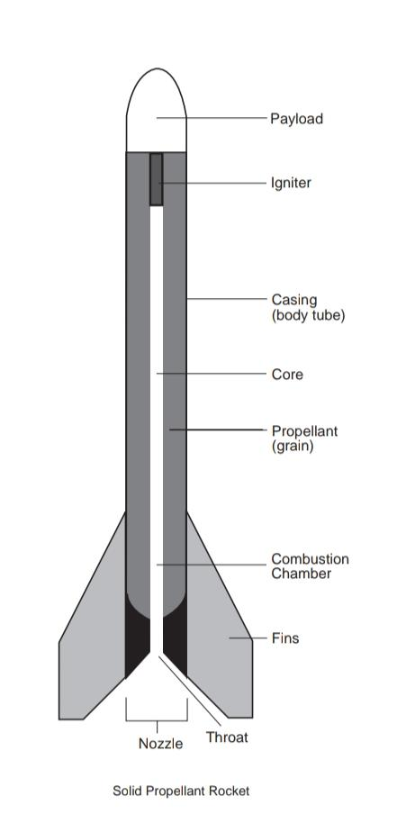
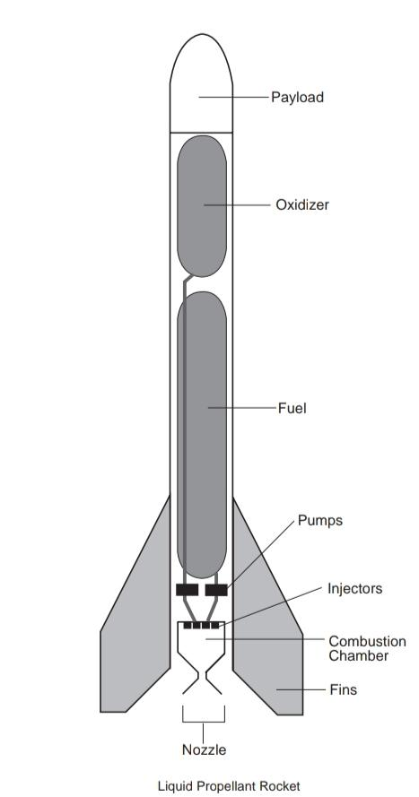
Practical Rocketry
Rocket propellant is the reaction mass of a rocket . This reaction mass is ejected at the highest achievable velocity from a rocket engine to produce thrust.
TYPES OF PROPELLANTS

Slide 7
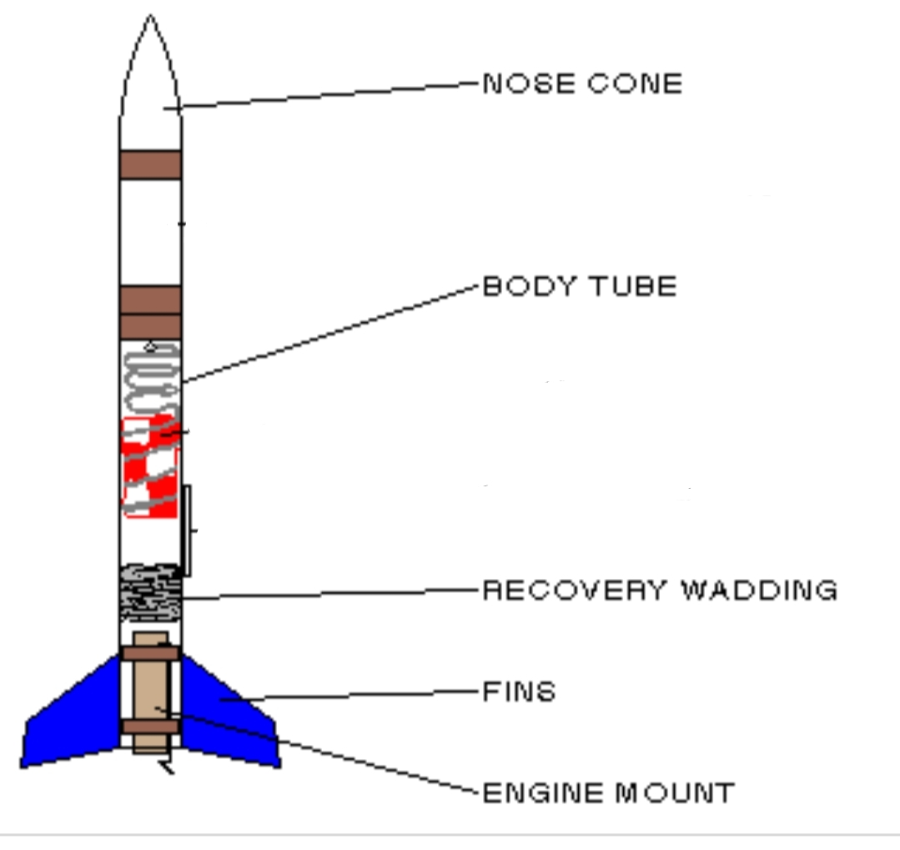
PARTS OF ROCKET
NOSE CONE
+
MOTOR ENGINES
+
FINS
+
BODY TUBE
+
SHOCK CORD
+
RECOVERY WADDING

Slide 8
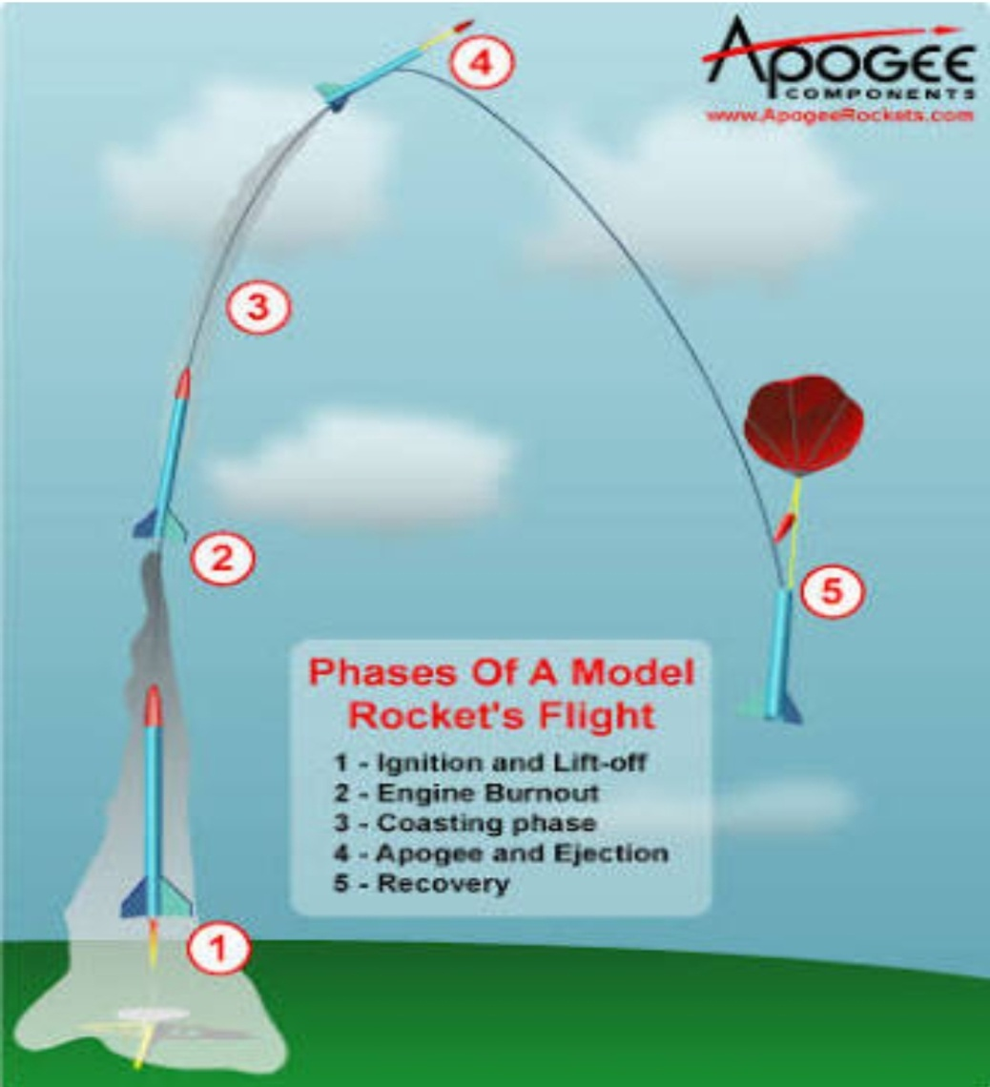
STAGES OF ROCKET

Slide 9
Engine Thrust Control
Solid propellant rockets are not easy to control as liquid rocket. The propellant burns until they are gone. So to control the thrust of rocket different type of pattern is used .

Slide 10
Checking the stability
Swing Test
The swing test is a basics idea to give you a rough idea how your rocket will fly. There are basically three things that can happen when you do this test; If you swing your rocket and it points in the direction you swing it, it is a good indication that your rocket will be a stable flyer. Sometimes a rocket will just cartwheel as you swing it. It is usually a sign that the CP and CG are too close together .

Slide 11
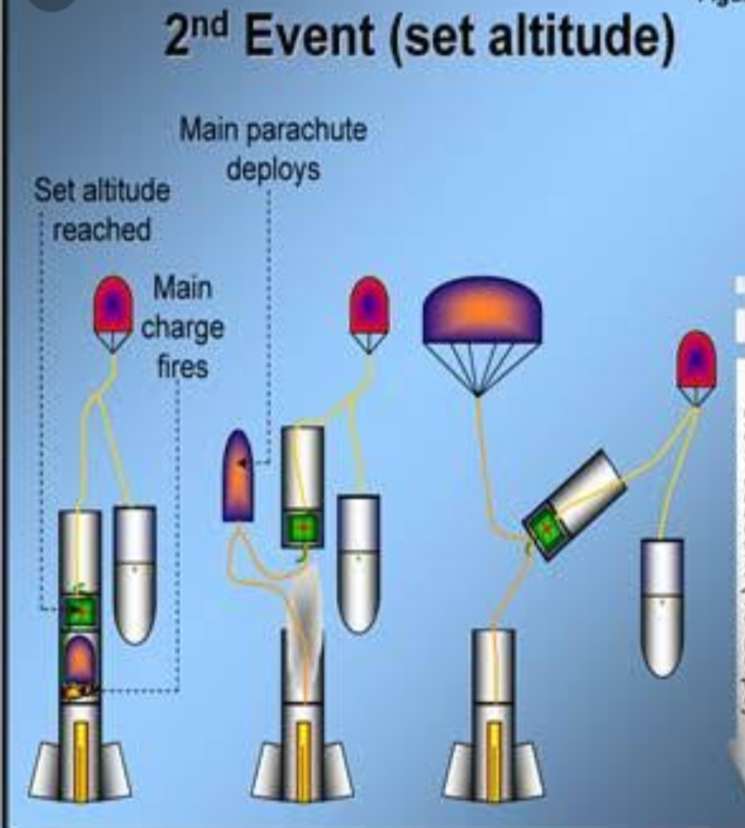
DEPLOYMENT OF PARACHUTE
It is defined as the process of extending the parachute canopy to a position at which satisfactory inflation can happen.3 It is important to deploy in a proper manner to collects data from rocket body or for reuse .

Slide 12
THANK YOU

